Slide 1
COMPUTER NETWORKS MINI PROJECT Wi-Fi Based Home Automation System
TEAM MEMBERS:-
K.SUKRUTH (RA2011003011281),
TALLURU VENKATA BHUVANESH (RA2011003011298),
N.VIVEK (RA2011003011302),
B.NIKSHIPTH NARAYAN (RA2011003011300).

Slide 2
Wi-Fi Based Home Automation System
ABSTRACT:-
Secure Wi-Fi technology is used by server, and hardware interface module to communicate with each other. User may use the same technology to log in to the server web-based application. If server is connected to the internet, so remote users can access server web-based application through the internet using a compatible web browser. For example, The home automation system can control the following appliances:
1) Lights on/off/dim
2) HVAC on/off
3) Door lock
4) Window shutdown
5) On/off different appliance and etc.

Slide 3
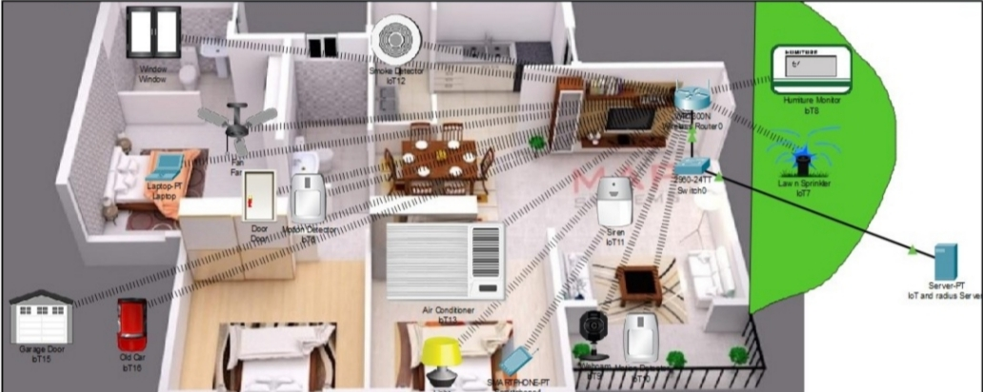
ARCHITECTURE AND DESIGN
The below figure shows the overall design of our system. There is a server setup which is connected to a switch and router. The IoT devices are connected to the server and can be accessed from anywhere within range.The devices can be accessed using a laptop or mobile which is also connected to the network
.

Slide 4
ARCHITECTURE AND DESIGN
The design shows how different devices can be connected inside a smart home through the internet of things. The different devices used for design are as follows –
1. IoT and Radius server - Remote Authentication Dial-In User Service is a networking protocol that provides centralized authentication, authorization, and accounting management for users who connect and use a network service.This server is to monitor intelligent things that are recorded on it and to have specific database features .
2. Router(WRT300N) - Used to link different devices to the network of cellular.
3. Laptop - Link to your home destination to access intelligent objects.
4. Smartphone - To access the IoT devices from anywhere.
5. Fan - Used for ventilating the home environment on the basis of certain circumstances.
6. Webcam - For security to see who is coming in the house it gets activated only when the motion detector detects any movement and the webcam takes pictures and sends it to the server.
7. Siren - Provide sound at home for some cases for example if fire breaks out.
8. Motion detector - Link to your home getaway and detect motion.

Slide 5
ARCHITECTURE AND DESIGN
9. Smart door - Link to your home getaway and detect motion to open or close automatically.
10. Lawn sprinkler - Used as a sprinkler based on environmental water level.
11. Smoke sensor - Used to sense the smoke level.
12. Older car - Used to model various home development scenarios as it affects the amount of oil, co2 and smoke. At a level of 1 percent an hour, this absorbs carbon monoxide. At a level of 2 percent an hour, this absorbs carbon dioxide. Affects Smoke at an hourly rate of 3%.
13. AC - Used at a level of -2 percent an hour to cool the home affects humidity.
14. Smart window - Used to remotely control the window impacts Argon, Carbon Monoxide, Carbon Dioxide, Hydrogen, Helium, Methane, Nitrogen, O2, Propane, and Smoke.
15. Smart Light - Used to give light for home.
16. Humiture Meter - Displays current humiture, which is (temperature+humidity)/2 to the closest integer

Slide 6
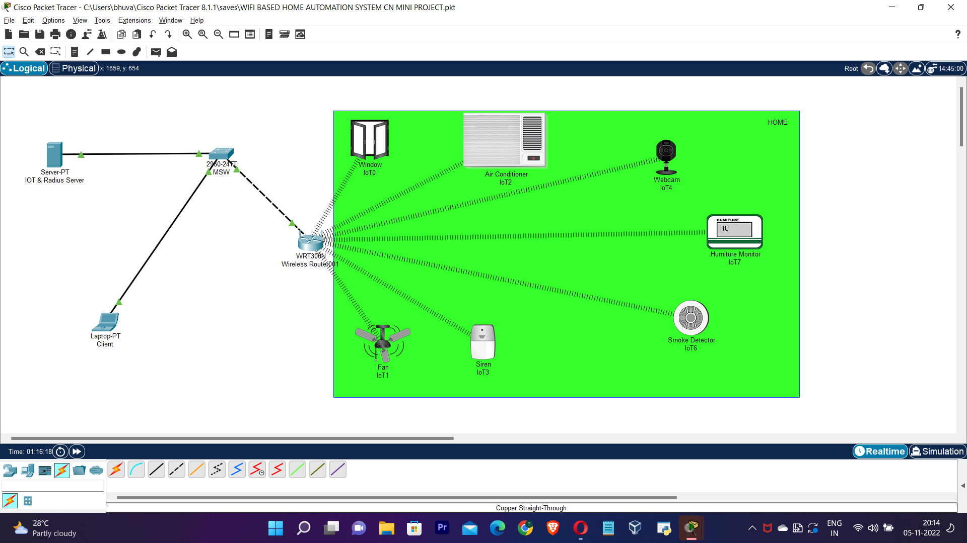
AFTER IMPLEMENTATION

Slide 7
CONCLUSION
We used the latest cisco packet tracer version to introduce smart home, as this version includes numerous IOE devices. We used the home portal for home automation and record smart devices for monitoring them and microcontroller (MCU-PT) to connect various sensors as well as IOE devices. MCU moreover offers computing environment for different devices and different language of programming.

Slide 8
THANK YOU

